Slide 1
CARTOONIFY IMAGE USING IMAGE PROCESSING AND MACHINE LEARNING
Group 14:
Adithyan P R
Aswin A
Joseph John

Slide 2
MOTIVATION
Our project aims at adopting Image processing using the OpenCV library for Python and Machine learning to convert ordinary images into cartoon versions.
Currently the "cartoonify" function is a tool for proprietary photoshop software in this project we aim to use free and open source development tools to make a cartoonify application.
Cartoonifying an image is a popular application in animation, game design and simple photo editing.

Slide 3
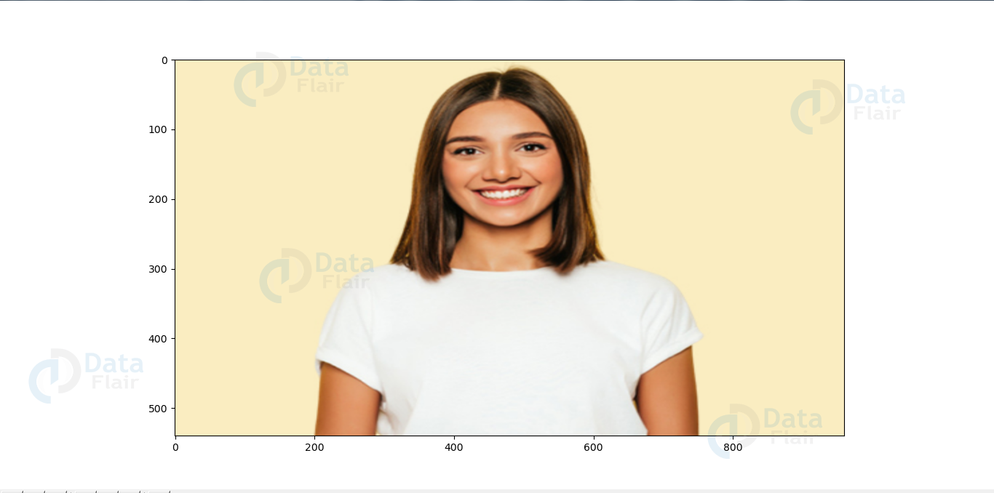
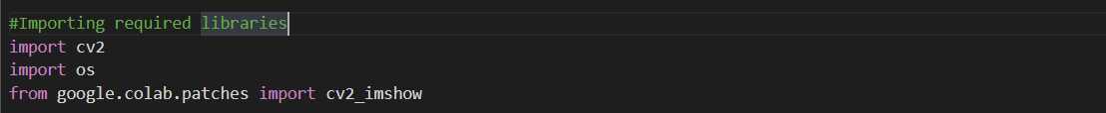
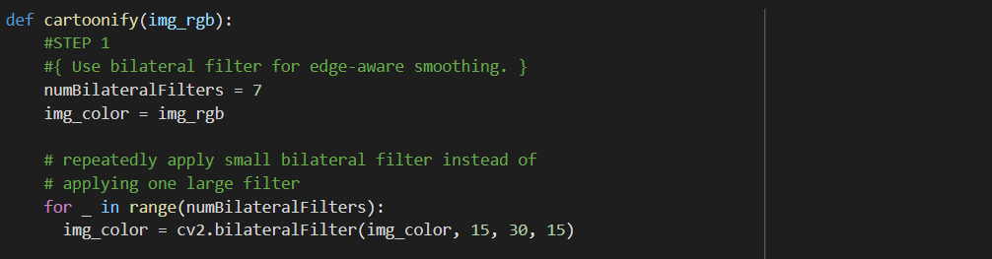
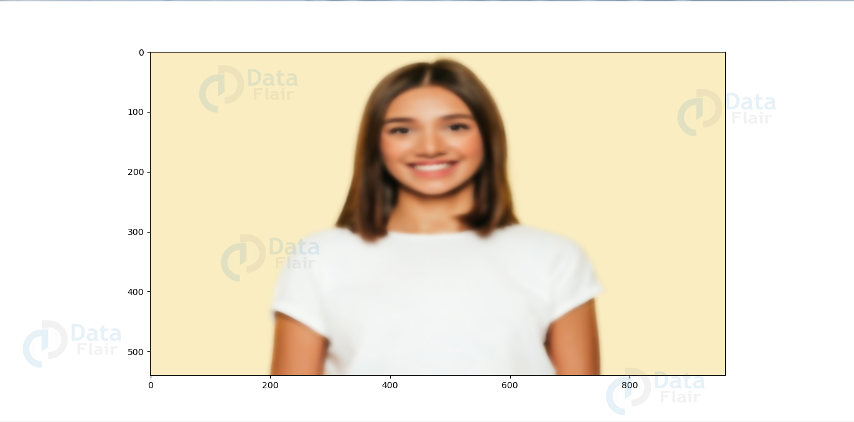
CODE
Original image
Applying bilateral filter
Firstly apply the bilateral filter to reduce the colour palette of the image.

Slide 4
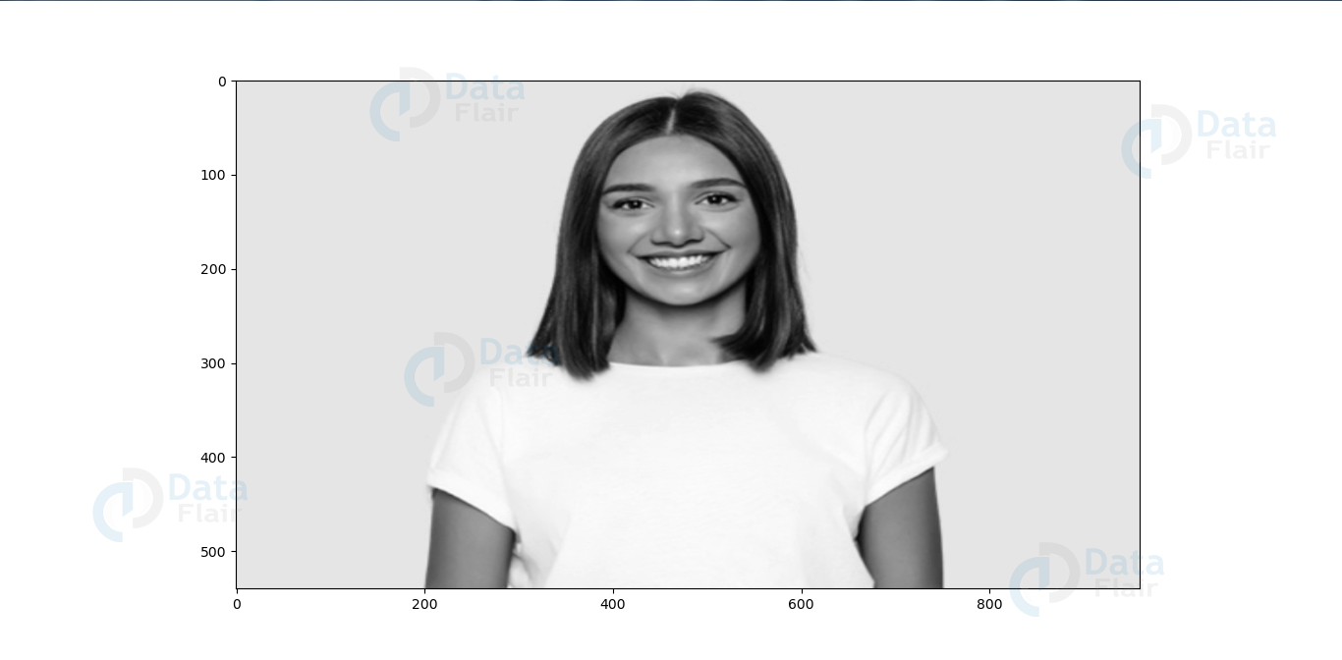
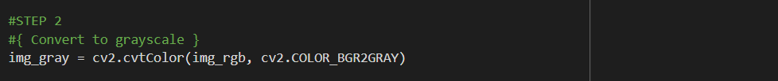
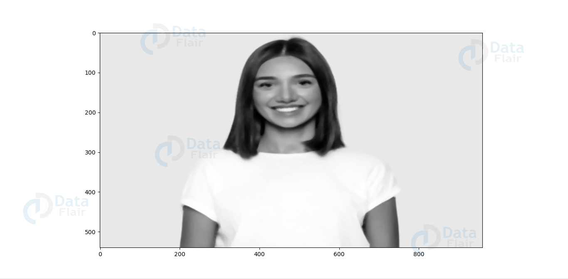
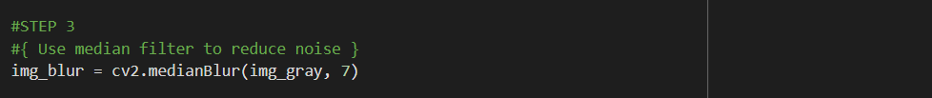
Image converted to greyscale
First, the image is converted to grey scale for detection of the edges according to each pixel data.
Smoothened grey image using medianBlur
Applying the medium blur in the greyscale image to reduce the image noise.

Slide 5
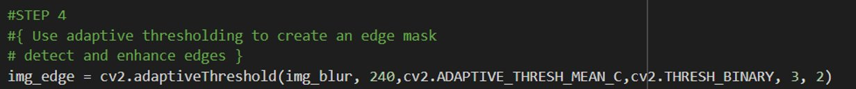
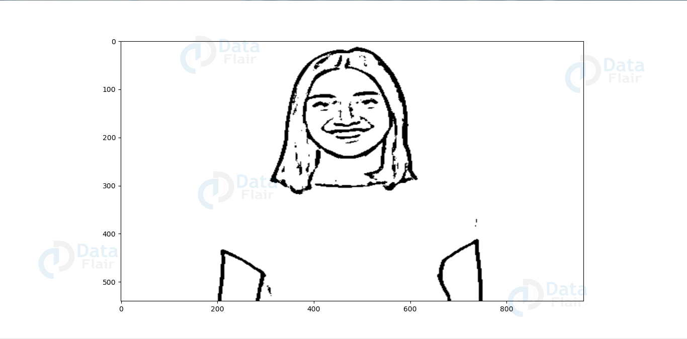
Cartoon effect has two specialties:
1.Highlighted Edges
2.Smooth colours
Here, we retrieve the edges and highlight them.
The main goal of adaptive threshold is to convert each pixel values in each region of an image into either completely black or completely white, depending on the mean value of the pixel overlapped by the kernel.
Edge masked image using adaptiveThreshold

Slide 6
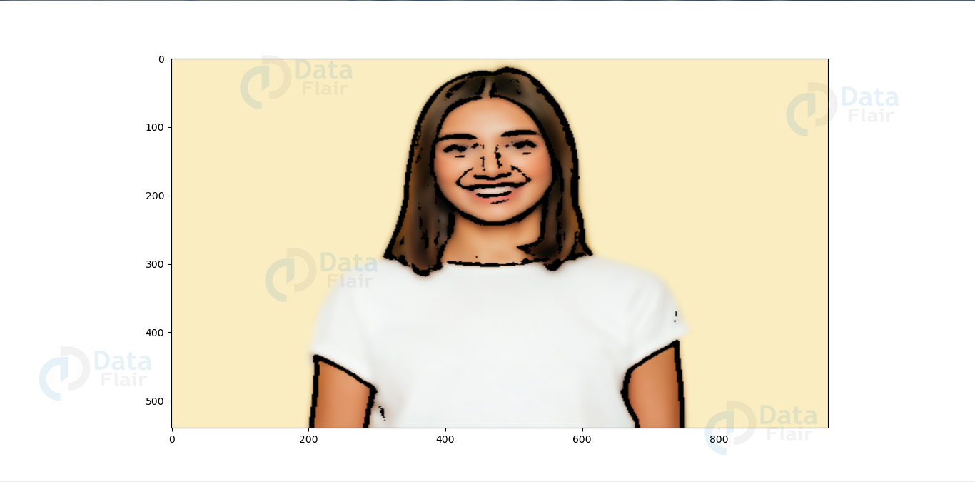
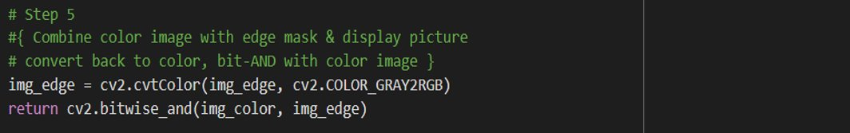
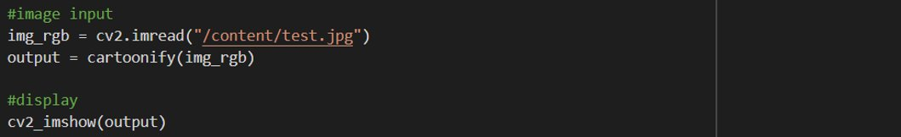
Cartoonified image after combining
Combining the image which had its edge masked and the other image which was the output from bilateral filter.
Giving an image input and calling the function "cartoonify" for catoonifying the image.

Slide 7
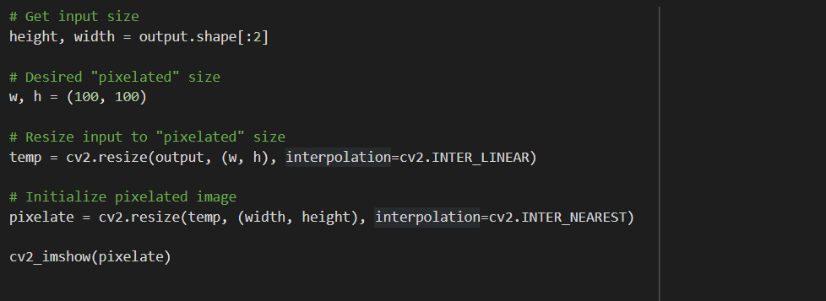
Pixelating the image with a resolution of 100 x 100 pixels.

Slide 8
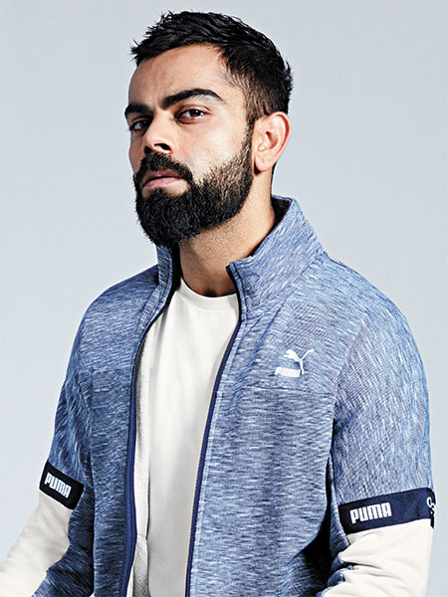
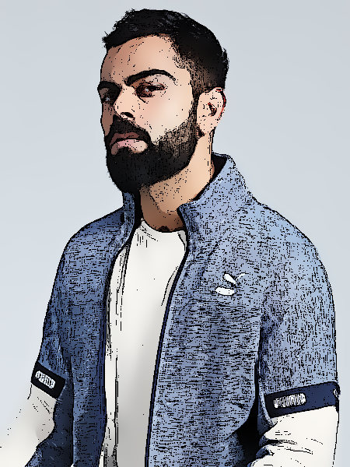
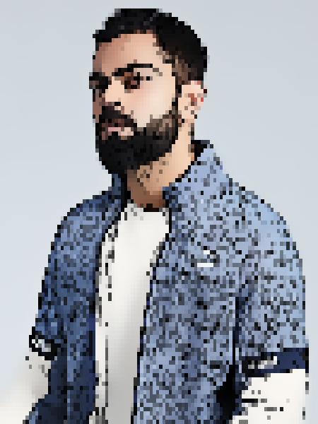
RESULT
Original
Cartoonified
Pixelated

Slide 9
Advantages and Disadvantages
Advantages
Disadvantages
Simple and Efficient Algorithm.
Free and Open source development tools.
Easily customizable parameters.
OpenCV gives same speed as implementation in C/C++.
Community support for OpenCV
As python development does not perform well on mobile platforms this application is not applicable for mobile apps.
Decrease in Resolution might produce Noisy images.
Output image dependent on Pixel Resolution.

Slide 10
Possible Future Improvements
Additional functions can be added to cartoonify such as cartoonify - " Oil Pastel", Cartoonify - "sketch" ,cartoonify - "Comic" etc.
01
Accuracy could be increased by using Higher Order Filters,but will increase memory
02
Cartoonify Video feature could also be added.
03
Portrait mode could be added using Face Detection Algorithm.
04

Slide 11

THANK YOU

